Slide 1
BUFFERED AND ISOTONIC
SOLUTIONS
By
Lec.Noor Yousif Fareed
2023/2024

Slide 2
Outlines & Objectives
Introduction
Buffer equation
Drugs as buffer
pH indicators
Buffer capacity
Buffer and biological system
Isotonic solution and methods of adjusting tonicity

Slide 3
Introduction
Buffers are compounds or mixtures of compounds that, by their presence in solution, resist the changes in pH upon the addition of small quantities of acids or alkali.
The resistance to a change in pH is known as buffer action.
While if a small amount of a strong acid or base, is added to water or NaCl solution, the pH is altered considerably (there is no buffer action).

Slide 5
The buffer equation

Slide 7
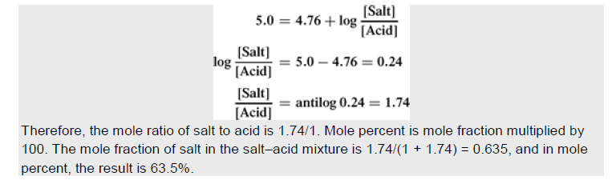
Q. What is the molar ratio [Salt]/[Acid] required to prepare an acetate buffer at pH= 5 (pKa= 4.76)

Slide 8
Q/ Why the buffer solutions are not ordinarily prepared from weak bases and their salts?
Because of:
The volatility and instability of the bases
The dependence of their pH on pKw which is often affected by temperature changes

Slide 9
Factors affecting pH of buffer solutions
- - - - - -- - - - - - - - -- - - -- - - -- - - - -
Note: Dilution value: is the change in pH on diluting the buffer solution to one half of its original strength.
Notes:
Ionic strength
The addition of water in moderate amounts, although not changing the pH, may cause a small positive or negative deviation because it alters activity coefficients and 'because water itself can act as a weak acid or base.
basic affect more because the temp affect Kw that is appear in the equation

Slide 11
Drugs as Buffer
It expected to
Note/ These actions are often weak (only one definite pH range) to counteract the pH changes brought about by CO₂ of the air and the bottle alkalinity, so the buffers must be added.

Slide 12
pH Indicators

Slide 13
Base Yellow color

Slide 14
Colorimetric methods for pH calculation
Applications:
Less expensive compared to other methods
Used for non color aqueous solution
Used for non aqueous solutions
Limitations:
Less accurate and less convenient.
They are acid or bases and if added to unbuffered solution causing significant change in pH.

Slide 15
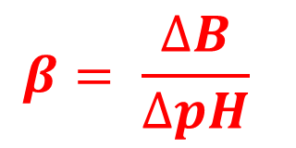
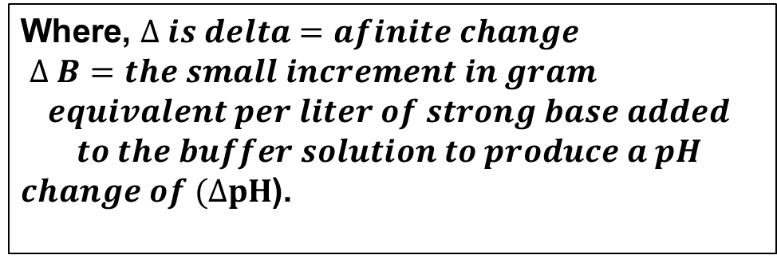
Buffer capacity
Or buffer efficiency, buffer index or value, represents the magnitude of the resistance of a buffer to pH changes. Or the ratio of the increment of strong base (or acid) to the small changes in pH brought about by this addition.
Then, according to this equation, addition of one gram equivalent of strong base (or acid) to one liter of the buffer solution results in the change of one pH unit.
Notes:
The buffer capacity is not a fixed value for a given buffer system but instead depends on the amount of base added.

Slide 16


How can you make an approximate calculation for buffer capacity?
For ex. Acetate buffer containing (0.1mole each of acetic acid and sodium acetate in one liter of solution) to which 0.01mole of NaOH is added
resulting in increase of salt conc. [Na⁺ Ac⁻] by (0.01 mole/liter), and [HAc] conc. decreases proportionally because each increment of base convert 0.01mole of acetic acid into 0.01mole of sodium acetate according to the following equation:
And

Slide 17
Buffer capacity
the buffer capacity depends on:
  (a) the value of the ratio [salt]/[acid], increasing as the ratio approaches unity
  (b) the magnitude of the individual concentrations of the buffer components, the buffer becoming more efficient as the salt and acid concentrations are increased.

Slide 18
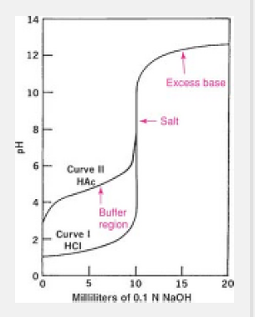
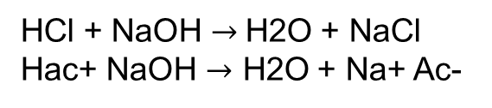
Neutralization curves and buffer capacity:
By considering the titration curves of strong and weak acids when they are mixed with increasing quantities of alkali, the reaction of an equivalent of an acid with an equivalent of the base called neutralization.
Notes:
a solution of a strong acid has a high buffer capacity below a pH of 2. Likewise, a base has a high buffer capacity above a pH of 12 .

Slide 19
Buffers in Pharma. & Biological systems
In vivo biologic buffer system:
Blood maintained the pH at 7.4 by so-called primary buffers in the plasma and the secondary buffers in the erythrocytes.
Plasma contains (carbonic acid/bicarbonate, acid/alkali salts of phosphoric acid and plasma proteins).
Erythrocytes contain two buffer systems (hemoglobin/oxy-hemoglobin and acid/alkali potassium salts of phosphoric acid).
It is usually life threatening for the pH of the blood to go below 6.9 or above 7.8, as in diabetic coma (pH as low as 6.8).

Slide 20
For urine, the 24-hr. urine collection of a normal adult have the pH averaging about 6 units, or it may be as low as 4.5 or as high as 7.8.
- When the pH of urine is below normal value, hydrogen ions are excreted by kidney. Conversely when the pH is about 7.4, hydrogen ions are retained by the kidney action.

Slide 21
Pharmaceutical buffers:
Are used for:
Formulation of ophthalmic solutions
Colorimetric determination of pH
Research studies in which pH must be held constant

Slide 22
There are different types with different pH ranges containing mixtures of solutions (found in pharmacopeia) with or without isotonicity enhancer (like NaCl).
  Mixtures of boric acid and monohydrated sodium bicarbonate at various proportions with pH range 5-9.
  Mixtures of the salts of sodium phosphate, pH range 6-8.
  Boric acid and sodium borate, range 7-9.
  NaOH and KH₂PO₄ , range 5.8-8

Slide 23
Influence of buffer capacity and pH on tissue irritation:
Tissue irritation, due to large pH differences between the solution being administered and the physiologic environment in which it is used, will be minimal:
the lower the buffer capacity of the solution,
the smaller the volume used, for a given concentration, and
the larger the volume and buffer capacity of the physiologic fluid.

Slide 24
Buffer capacity and tissue irritation:
Eye irritation my be resulted from the presence of free form of a drug at the physiologic pH, it is more often due to the acidity of the eye solution.
Phosphate buffer can cause more irritation than boric acid buffer due to higher buffer capacity of Ph buffer.
Parenteral solution are usually not buffered or they are buffered to a low capacity so that, the buffer of the blood may readily bring them within the physiologic pH range.
For oral administration, like aspirin is absorbed more rapidly in system buffered at low buffer capacity than in system containing no buffer or in highly buffered preparations. Gastric irritation is also affected by buffer capacity.

Slide 25
Stability versus optimum therapeutic response:
Undissociated form of weakly acidic or basic drugs often has a higher therapeutic activity than the dissociated salt form (less lipophilic).
For ophthalmic drugs (weakly basic alkaloid, pilocarpine, pk_{b}= 7.15), therapeutic response is increased as the pH of solution and hence the concentration of the undissociated base were increased.
At low pH about 4, ionic form predominates, so low penetration or slow.
Tears with pH about 7.4, the drug found mainly in free base form.

Slide 26

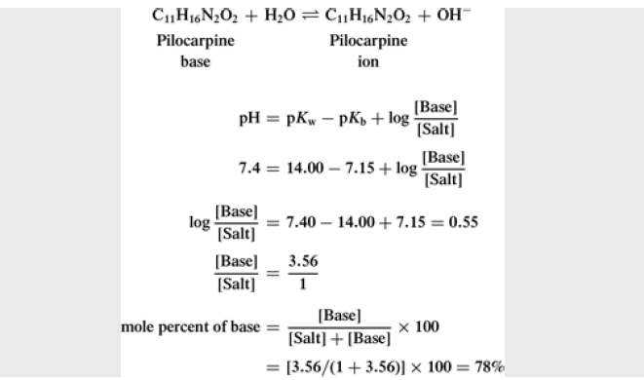
The solutions of drugs can be buffered al a low buffer capacity and at pH that is a compromise between that of optimum stability and the pH for maximum therapeutic action.

Slide 27
pH & Solubility
The influence of buffering on the solubility of an alkaloidal base:
At a low pH, a base is predominantly in the ionic form, which is usually very soluble in aqueous media.
As the pH is raised, more undissociated base is formed.
When the amount of base exceeds the limited water solubility of this form, free base precipitates from solutthe ion.
Therefore, the solution should be buffered at a sufficiently low pH so that the concentration of alkaloidal base in equilibrium with its salt is calculated to be less than the solubility of the free base at the storage temperature.
Stabilization against precipitation can thus be maintained.

Slide 28
Buffered Isotonic Solutions
Isotonic solutions cause no swelling or contraction of the tissues with which they come in contact, and produce no discomfort when instilled in the eye, nasal tract, blood, or other body tissues.
Hypertonic solution: ….. Shrink RBCs
Hypotonic solution: ……. Haemolysis
Notes:
Isotonic sodium chloride is a familiar pharmaceutical example of such a preparation.
Similar osmotic pressure

Slide 30
Methods of Adjusting Tonicity & pH
A solution having the same osmotic pressure as a specific body fluid is termed isotonic (meaning of equal tone) with that specific body fluid.
Solutions of lower osmotic pressure than that of a body fluid are termed hypotonic, whereas those having a higher osmotic pressure are termed hypertonic.
Pharmaceutical dosage forms intended to be added directly to the blood or mixed with biological fluids of the eye, nose, and bowel are of principal concern to the pharmacist in their preparation and clinical application.

Slide 31
Cryoscopic Method:
The calculations involved in preparing isotonic solutions may be made in terms of data relating to the colligative properties of solutions. Theoretically, any one of these properties may be used as a basis for determining tonicity. Practically and most conveniently, a comparison of freezing points is used for this purpose.
It is generally accepted that -0.52 C is the freezing point of both blood serum and lacrimal fluid.

Slide 33
Sodium Chloride Equivalent Method:

Slide 35

Thanks for your attention

